Slide 1



Analyzing the Federal Reserve's Dual Mandate
This presentation examines the Federal Reserve's efforts to control inflation and unemployment through rate hikes and cuts. We'll analyze the effectiveness of these strategies over the past 25 years using key economic indicators.
by Waheeb Algabri

Slide 2

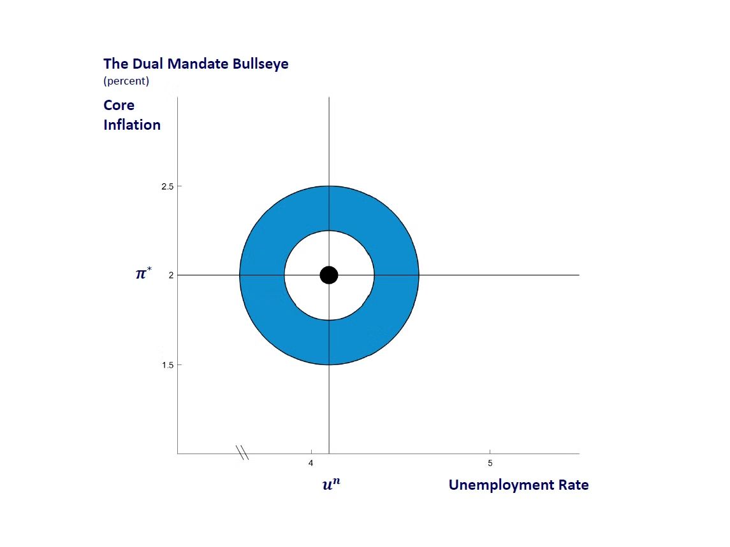
Introduction to the Federal Reserve’s Mandate
Title: Overview of the Federal Reserve's Mandate
The Federal Reserve aims to manage inflation and unemployment through its dual mandate. We'll analyze the effectiveness of rate hikes and cuts over 25 years to answer this question.
Has the Federal Reserve Fulfilled Its Mandate?
1
Inflation
Measured by CPI growth
2
Unemployment Rate
Key indicator of economic health
3
Fed Funds Rate
Primary tool for monetary policy

Slide 3
Data Sources and Methods
Data Sources
Analysis Methods
CPI and Unemployment from BLS. Federal Funds Rate from FRED.
Calculating changes during rate cycles. Visualizations created in R using ggplot2.

Slide 4
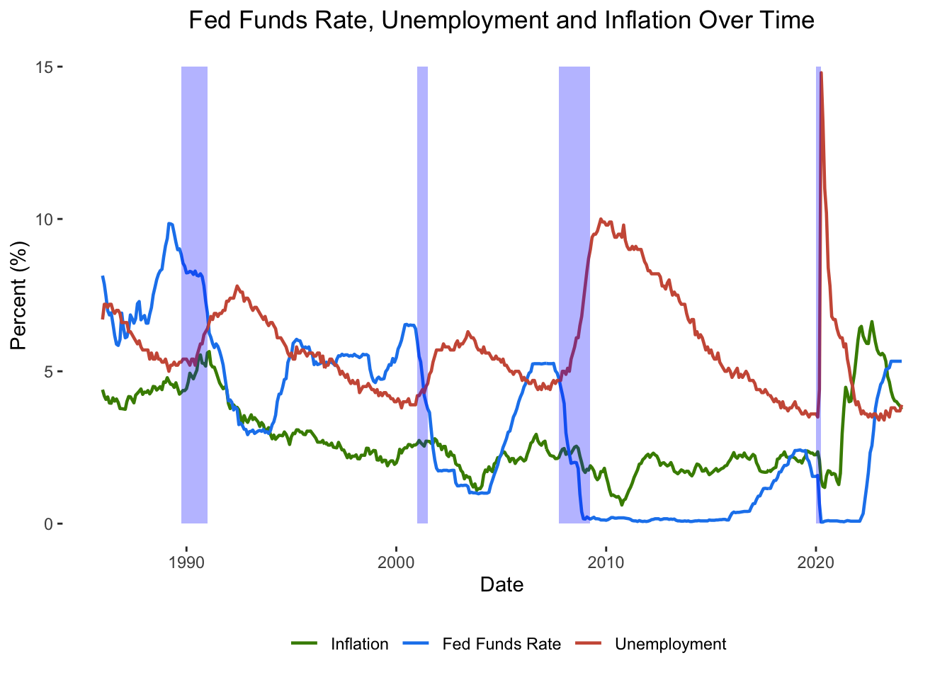
Fed Funds Rate, Unemployment, and Inflation Over Time

Slide 5
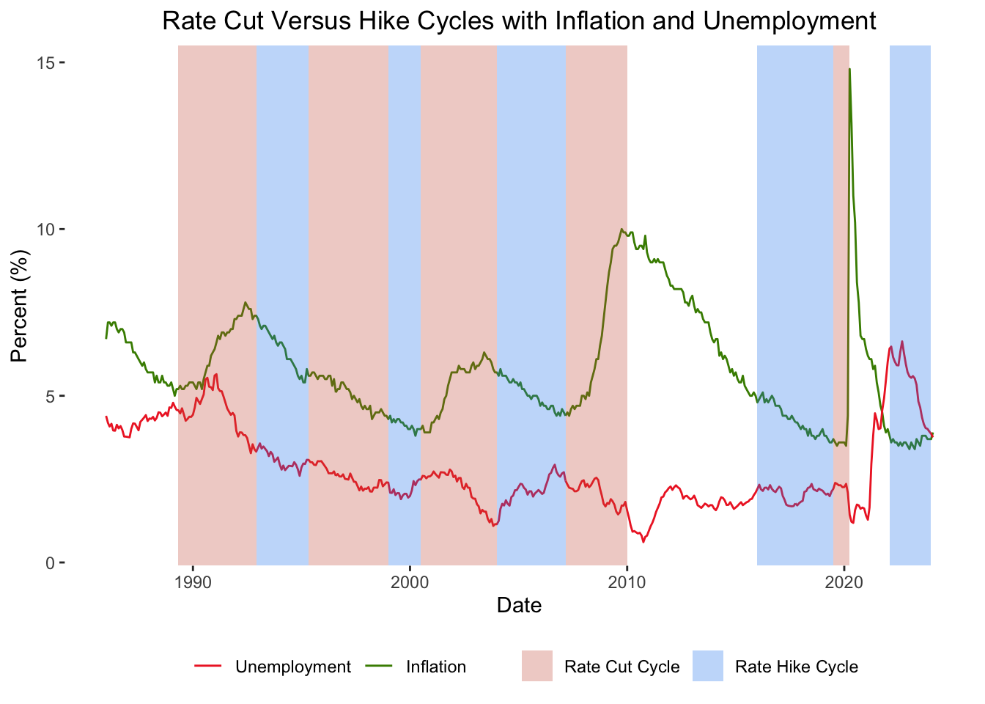
Rate Cut and Hike Cycles

Slide 6
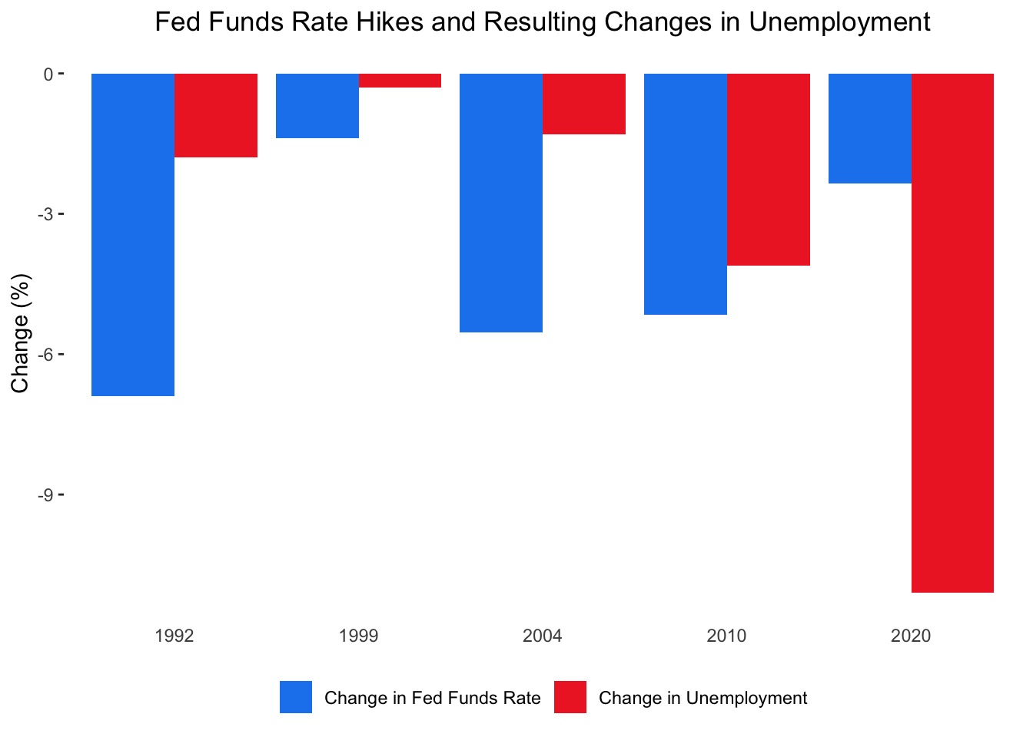
Effects of Rate Cuts on Unemployment and Inflation

Slide 7
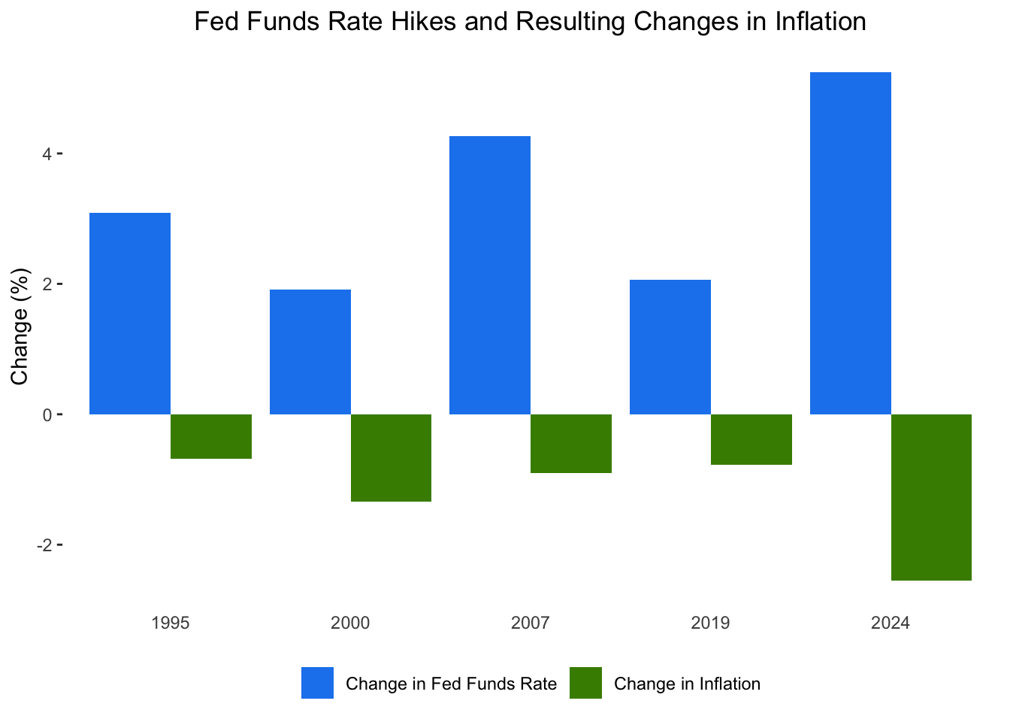
Effects of Rate Hikes on Inflation and Unemployment

Slide 8
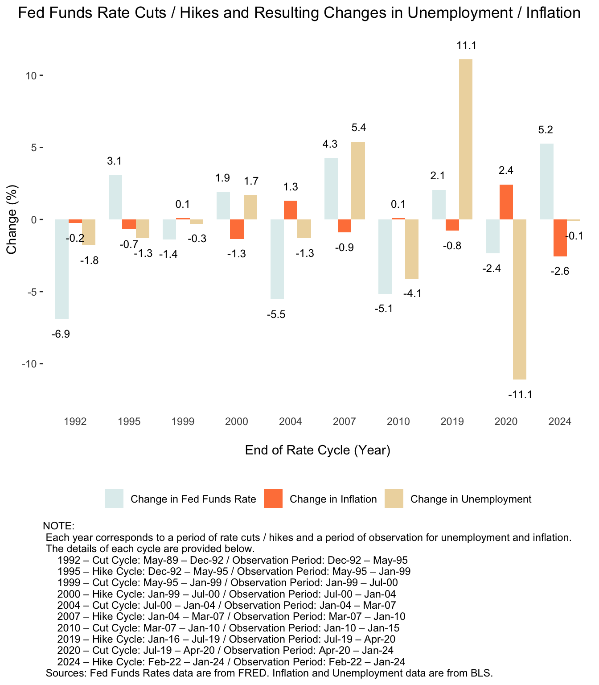
Conclusion
The Fed has successfully curbed inflation through rate
hikes but often at the expense of higher unemployment.
Rate cuts have generally helped boost employment,
though sometimes at the cost of rising inflation.
The Fed’s challenge lies in balancing these competing
objectives, and while it has made notable strides,
its ability to simultaneously manage both has been met
with mixed results.

